Slide 1
Puzzle
“Who in the world am I? Ah, that’s the great puzzle.” ~ Lewis Carroll

Slide 2

Mission…
“Using the recognition gained build a testable map of a high level architecture from evidence and experimentation”

Slide 3

Objectives…
Learning Objectives:
Interpret multiple oracles of information to determine a previously unarticulated architecture
Diagram the architecture using common architectural notations and visual dictionary from the first exercise
Assess architectural evidence to determine reliability of the available oracles

Slide 4

Oracle Problem!

Slide 5
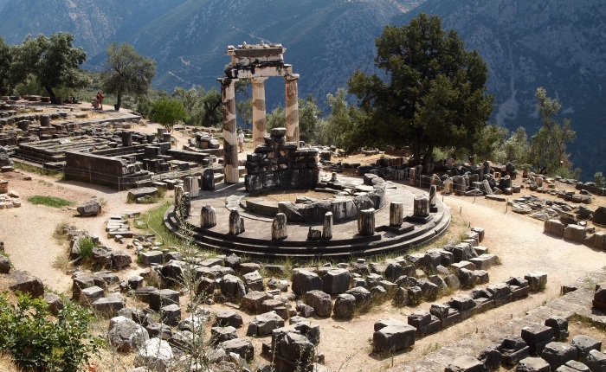
Oracles!
Symbols
Anecdotes
Bugs
Original Diagrams
Performance Statistics
Some are useful
Some contradict each other

Slide 6
Story so far
ID Resolver – a credit application processor, decides based on your credit card, bank account and address history whether or not to loan you money.
You are a new internal development team, picking up this application from the previous builders and maintainers, who have (nearly) all moved on.
The application runs on Linux and is built in php primarily, with predominantly HTTP API consumers, but some web based consumers too.
The data storage is in MySQL, caching uses Memcache.
The original team built it as a proof of concept but that quickly became the production system. Scaling issues have been prevalent since.
The product is supported by a Database admin team, a single Linux Sys Admin and the main service desk.
Ash is the only surviving member of the old team…

Slide 7
For example…
Produce a diagram of the architecture as it is now
Based on the oracles provided
Start with the original diagram, then bugs, stories and data…
Suggest drawing a layer at a time

Slide 8

Summarise…
To you…
To Me…

